Slide 1

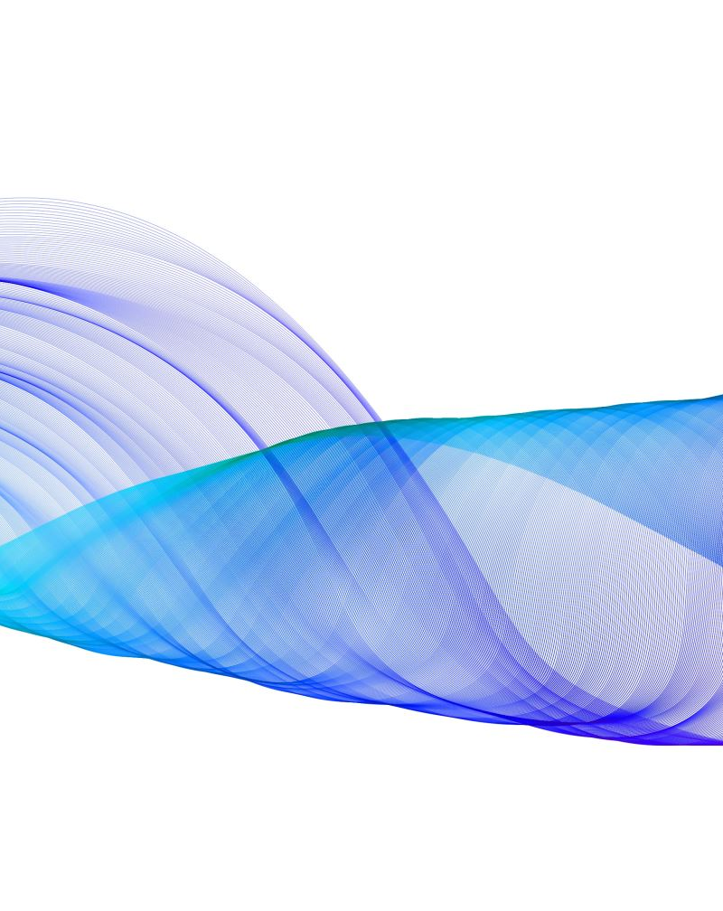
Sports Image Classification Using Custom ResNet-50
- By SHAH FAHAD

Slide 2
The Dataset
Dataset has 7 sports classes: Badminton, Cricket, Karate, Soccer, Swimming, Tennis, Wrestling
Around 8,500 images – not too small, not too big
Each sport looks visually different — good for learning CNNs
Real-world images, not synthetic — perfect for practical learning

Slide 3
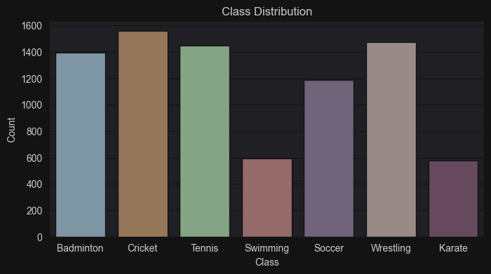

Slide 4
Data Preprocessing & Augmentation
Resized all images to 224x224 pixels
Normalized using ImageNet mean & std
Applied data augmentation: Random flips, Rotations, and Random resized crops
Helped prevent overfitting and improved generalization

Slide 5
The Model: ResNet- 50
Initially built a CNN from scratch, but it didn't give good accuracy. It was slow to train and didn't learn complex patterns well.
Then I tested ResNet-18 and ResNet-34, which were better,
but still not strong enough for my 7-class problem with detailed images.
Finally, I chose ResNet-50, and it gave the best results

Slide 6
Why ResNet-50 was best):
Deep architecture with 50 layers: Can learn more complex features than shallow networks.
Pretrained on ImageNet: Already knows how to detect edges, textures, and shapes — so it didn’t need to learn from scratch.
Only fine-tuned the last fully connected layer: This saved time and computing power. I didn’t have to retrain the whole model.
Worked best on my dataset: Achieved highest validation and test accuracy compared to other models I tried.
In short, ResNet-50 gave me the best balance of power, speed, and accuracy — ideal for this classification task.

Slide 7
Architecture & Hyperparameter Tuning
Architecture: 50-layer ResNet, fine-tuned final layer
Hyperparameters tuned using Grid Search:
Learning rate: 0.01
Batch size: 16
Optimizer: SGD
Used early stopping after 3 epochs with no improvement

Slide 8
Learning Rate | Batch Size | Optimizer | Val Acc | Learning Rate | Batch Size | Optimizer | Val Acc
0.0200 | 16 | adam | 0.7568 | 0.0200 | 16 | sgd | 0.6135
0.0200 | 32 | adam | 0.7514 | 0.0200 | 32 | sgd | 0.7730
0.0100 | 16 | adam | 0.6946 | 0.0100 | 16 | sgd | 0.8108
0.0100 | 32 | adam | 0.7351 | 0.0100 | 32 | sgd | 0.7757
0.0050 | 16 | adam | 0.7135 | 0.0050 | 16 | sgd | 0.7676
0.0050 | 32 | adam | 0.8054 | 0.0050 | 32 | sgd | 0.8162
0.0020 | 16 | adam | 0.7622 | 0.0020 | 16 | sgd | 0.7432
0.0020 | 32 | adam | 0.7784 | 0.0020 | 32 | sgd | 0.7676
0.0010 | 16 | adam | 0.7541 | 0.0010 | 16 | sgd | 0.7432
0.0010 | 32 | adam | 0.7784 | 0.0010 | 32 | sgd | 0.6811
0.0005 | 16 | adam | 0.7595 | 0.0005 | 16 | sgd | 0.6459
0.0005 | 32 | adam | 0.6568 | 0.0005 | 32 | sgd | 0.6081

Slide 9
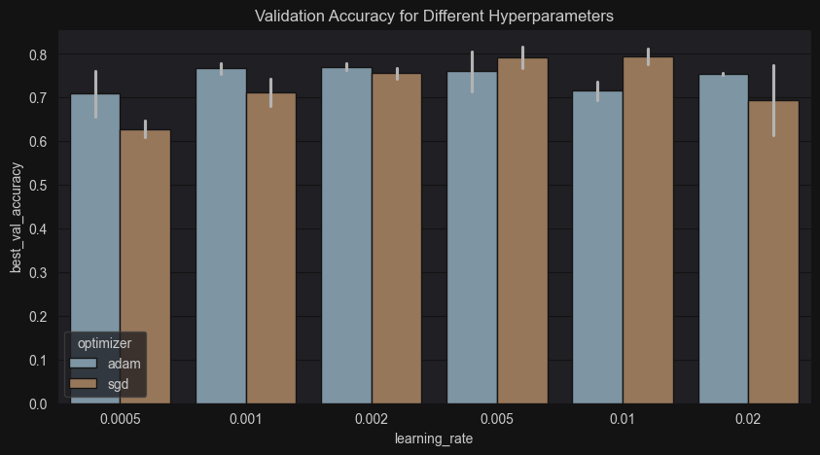

Slide 10
Training Progress & Best Results
Early stopping stopped at Epoch 6, total 10 epochs
Best validation accuracy: 89.80%
Final test accuracy: 89.64%
Model worked best for: Swimming and Wrestling
Karate needed improvement (low precision)

Slide 11
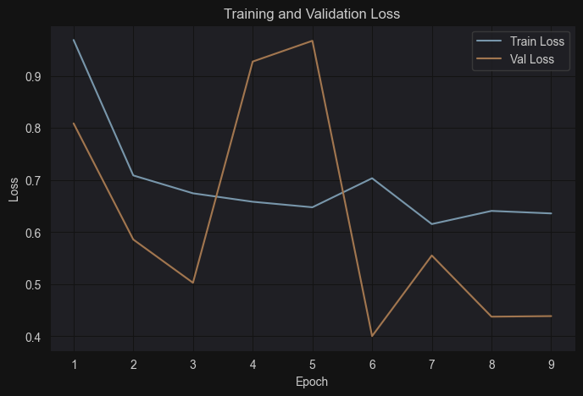

Slide 12
Evaluation Results
Confusion matrix helped find misclassifications
F1-Scores: Highest: Swimming (0.97) and Wrestling (0.94)
Karate often confused with Wrestling
Tennis confused with Badminton
Overall, model generalized well (no overfitting signs)

Slide 13
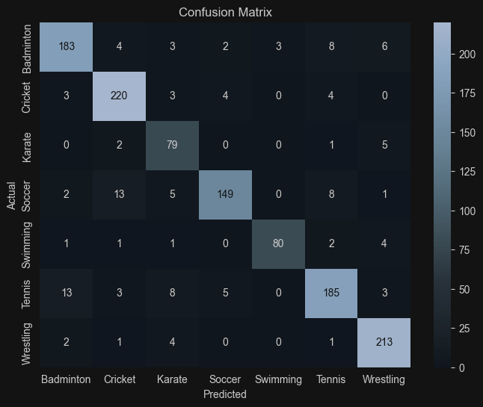

Slide 14
Final Test Results
Test Accuracy: 89.64%
Strong precision and recall across all classes.
Especially strong for: Swimming and Wrestling
Karate needs improvement in precision.

Slide 15
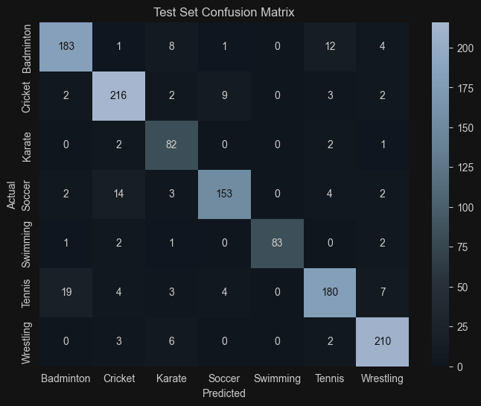

Slide 16
Experiences
At first, I was confused about which dataset to choose.
I selected the Sports Image Dataset because it looked clean, balanced, and easy to work with.
Building the CNN model was challenging, but I understood the layers slowly.
I did Grid Search to find the best learning rate, optimizer, and batch size.
Faced problems with loss going up and down, but I learned how early stopping helps.
Fixed multiple errors during training and evaluation with research and practice.
Achieved 90% accuracy and was happy with how the model performed.

Slide 17
Challenges
Deciding between CNN vs Pretrained ResNet
Understanding how to fine-tune pretrained layers
Manual Grid Search was slow and repetitive
Limited GPU memory — couldn’t use large batch sizes
Needed to try multiple hyperparameter combinations

Slide 18
My Learnings
Got to know how layers work in PyTorch.
Used patience based-early stopping to control overfitting.
Tried different hyperparameters using Grid Search.
Learned to check model performance using metrics.
Understood how to read loss and accuracy graphs.
Learned the full process of image preprocessing and data augmentation.
Got hands-on experience with modifying pretrained CNN model from scratch.

Slide 19
The Conclusion & Future Improvements
My ResNet-50 model achieved almost 90% accuracy
Learned all stages of deep learning pipeline:
Data prep → model selection → tuning → evaluation
Future plans:
Try other lightweight models
Use L2 regularization or batch normalization
Balance classes with weighted loss
Apply more aggressive data augmentation

Slide 20
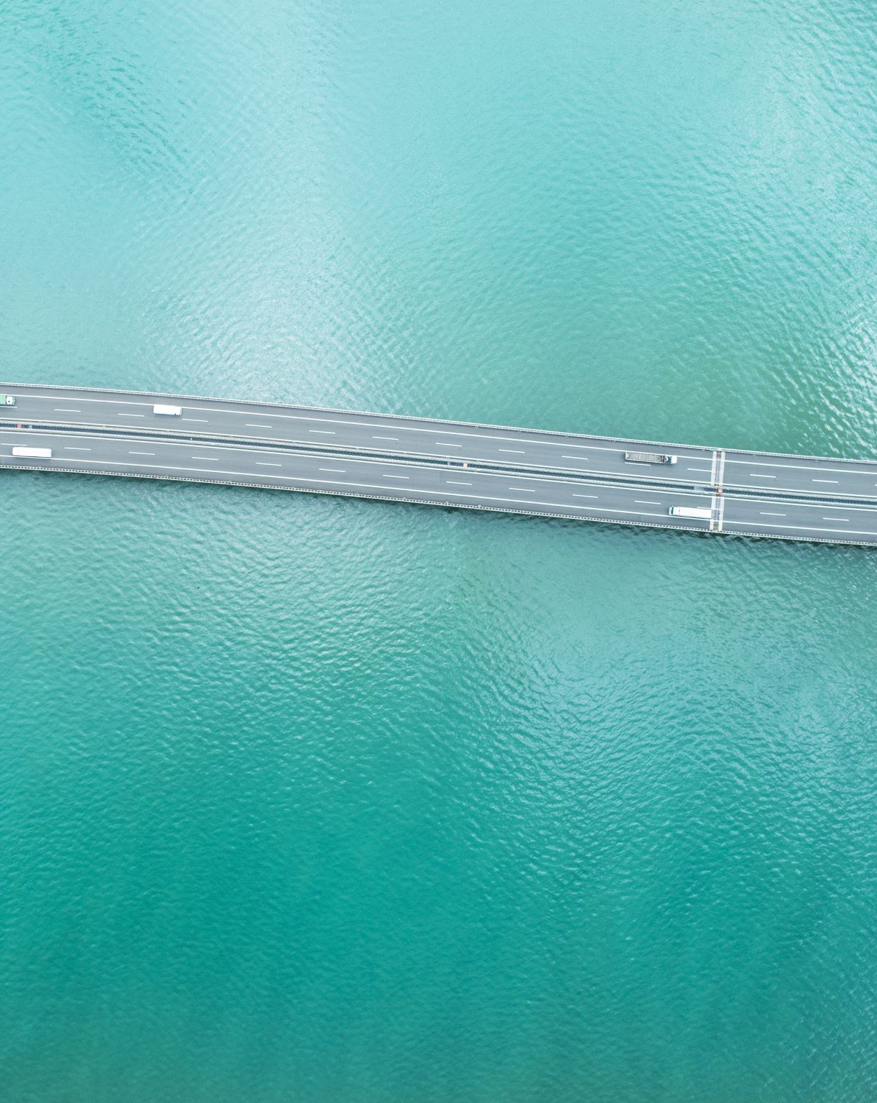
THANK YOU

